Slide 1
CEE 111 Engineering Drawing
Course Instructor: Dr. Vishal Deshpande
Asst. Professor, Department of Civil and Environmental Engineering
email: deshpande@iitp.ac.in

Slide 2
Course Structure
1-0-3-5
Theory 1 hr each week (14 Theory classes)
Tutorial 3 hrs every week (14 Tutorial classes)

Slide 3
Class Structure
Two Theory Groups
Group 1 (CSE + CE + CB) Thursday 10:00 AM to 10:55 AM (R102/9)
Group 2 (ME + EE) Friday 12:00 PM to 12:55 PM (R104/9)
Four Tutorial Groups
Group 1 (CE + CB) Monday 2:00 PM to 5:00 PM
Group 2 (CSE) Tuesday 2:00 PM to 5:00 PM
Group 3 (EE) Thursday 2:00 PM to 5:00 PM
Group 4 (ME) Friday 2:00 PM to 5:00 PM

Slide 4
Course Tutors
Group 1 (CE +CB) Dr. Vishal Deshpande
Group 2 (CSE) Dr. Amarnath Hegde
Group 3 (EE) Dr. Ramakrishna Bag
Group 4 (ME) Dr. Sudhir Varma

Slide 5
Topics (Theory)
Geometrical construction of simple plane figure
Curves
Drawing scales
Orthographic projection
Projection of points, lines and plane
Missing views
Orthographic projection of simple solid
Course Books
Engineering Drawing: B. Agrawal and CM Agrawal
Engineering Drawing: D. A. Jolhe
Engineering Drawing: N. D. Bhatt

Slide 6
Marks Distribution
Tutorial work will be graded = 25%
Mid Semester Exam = 25%
End Semester Exam = 50%
_________________________________________
Total = 100%

Slide 7
Course Requirements
A minimum of 75% attendance is must to appear in the end semester examination
Students coming late will not be allowed in the class
Please carry all your drawing equipments to all the tutorial classes
Copying and Plagiarism: Copying of assignments and tutorials is not allowed and will attract disciplinary action such as debarring from exam or even expulsion!

Slide 8

Discipline and General Etiquettes

Slide 9
Fundamentals of Engineering Drawing
Engineering Drawing is language of engineers to describe products.

Slide 10
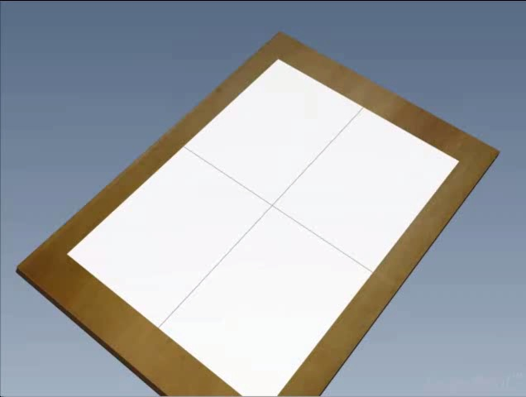

Things you need for Engineering Drawing
BIS SP:46(1988) A₃ 297 x 420

Slide 11
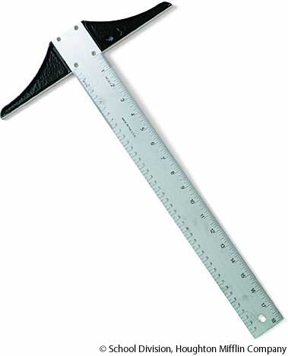
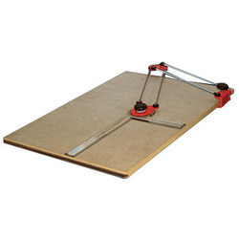
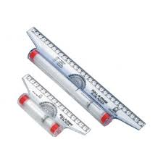
Things you need for Engineering Drawing

Slide 12
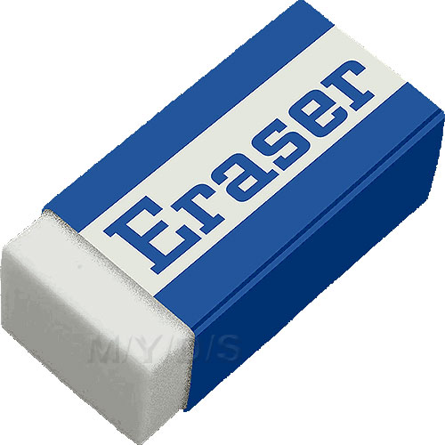

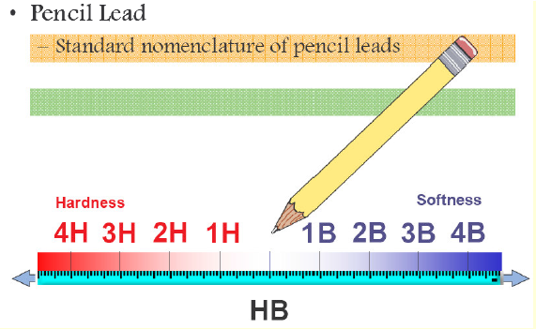
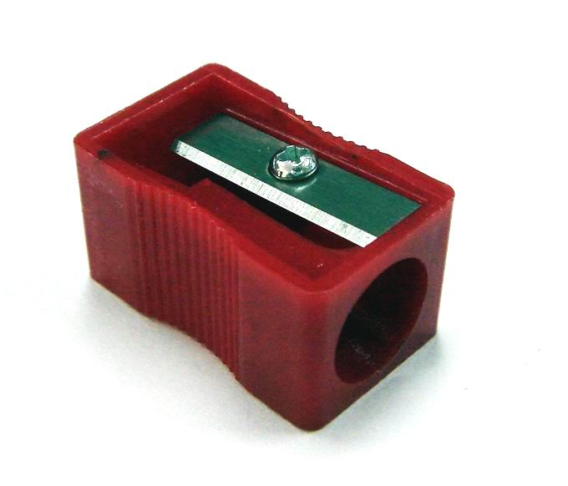
Things you need for Engineering Drawing

Slide 13
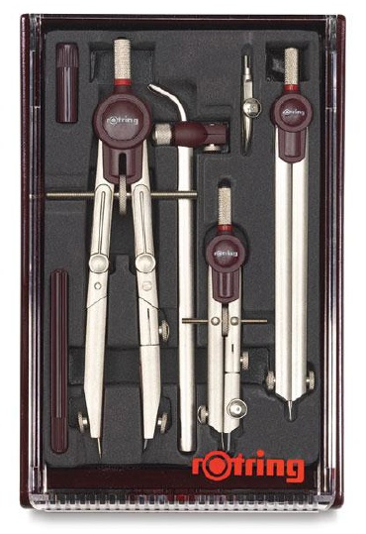
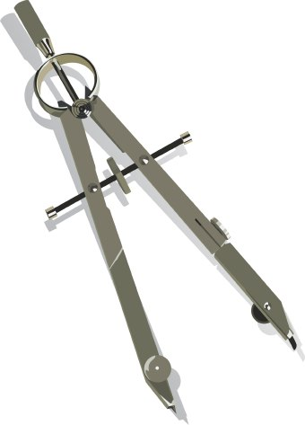
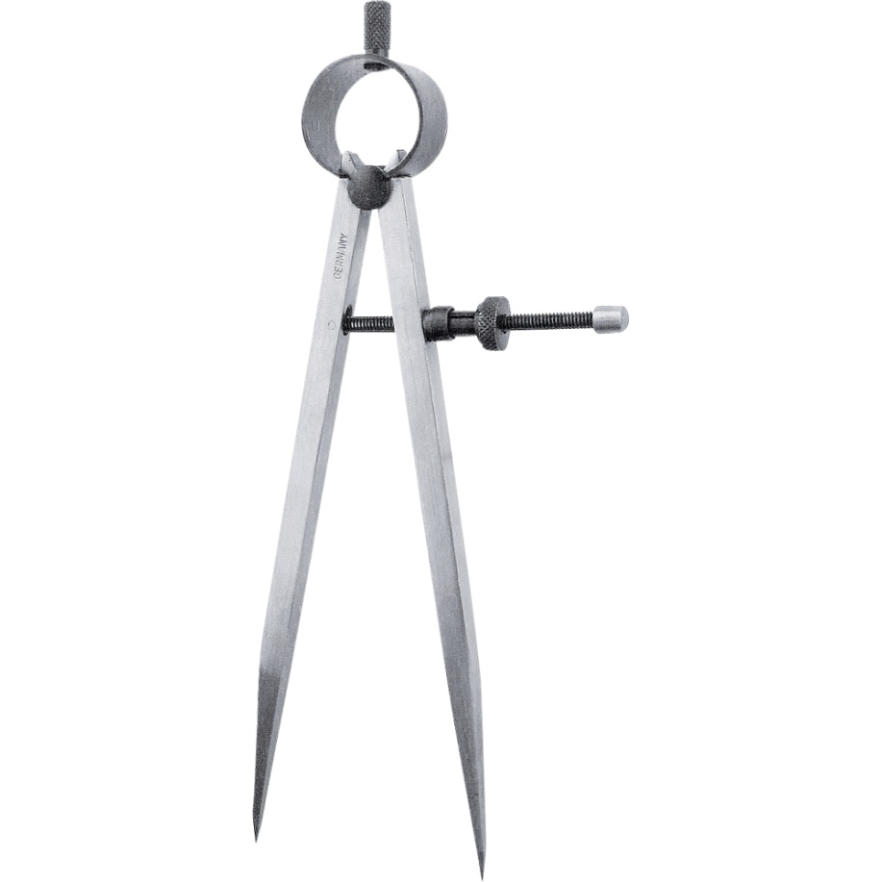
Things you need for Engineering Drawing

Slide 14
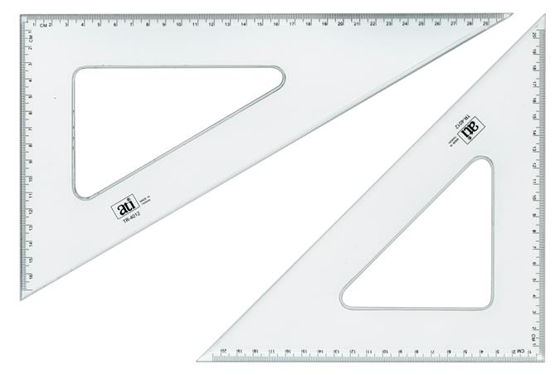
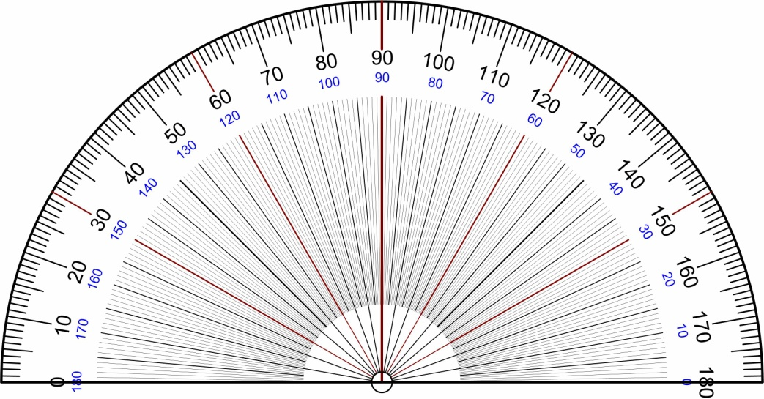
Things you need for Engineering Drawing

Slide 15
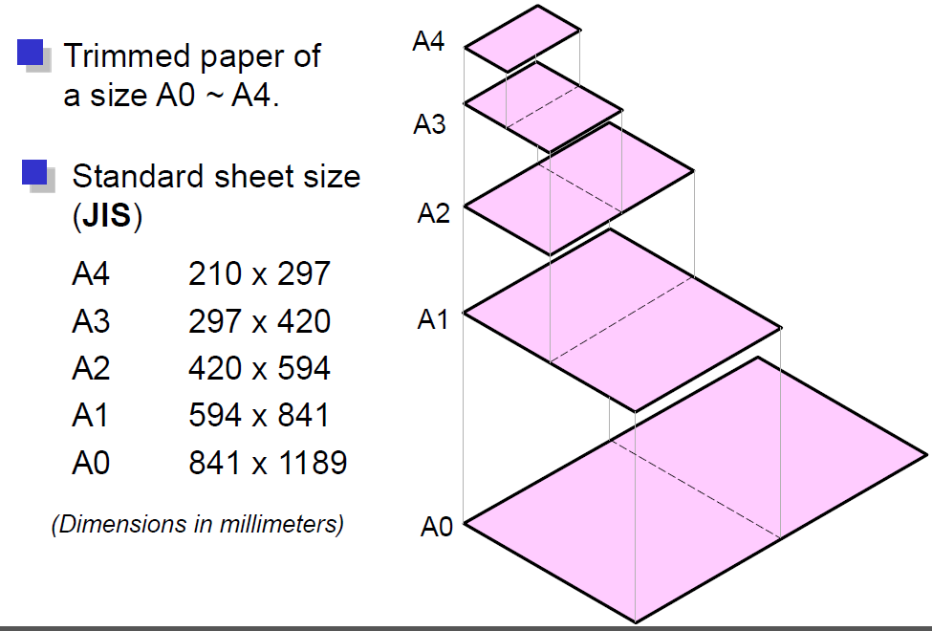
Sheet Sizes

Slide 16
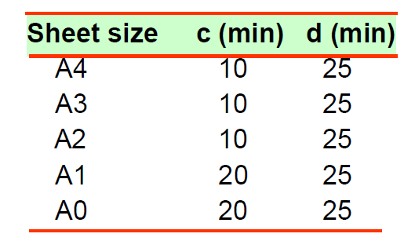
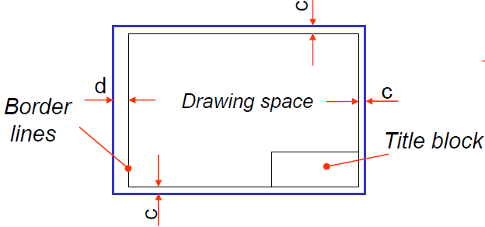
Sheet Layout

Slide 17
Title Block
5-10-5-10-5-10-5-10-5
All in BLOCK letters
Title block Dimension should be 185 mm X 65 mm
Name and Roll Number
Title of the Sheet
Scale
Date

Slide 18
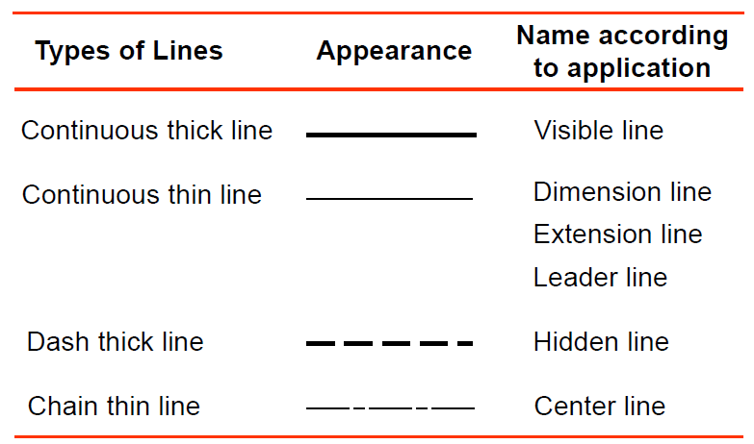
Lines

Slide 19
Lines
Visible lines represent features that can be seen in the current view
Hidden lines represent features that can not be seen in the current view
Centre line represents symmetry, path of motion, centres of circles, axis of axis-symmetrical parts
Dimension and Extension lines indicate the sizes and location of features on a drawing

Slide 20
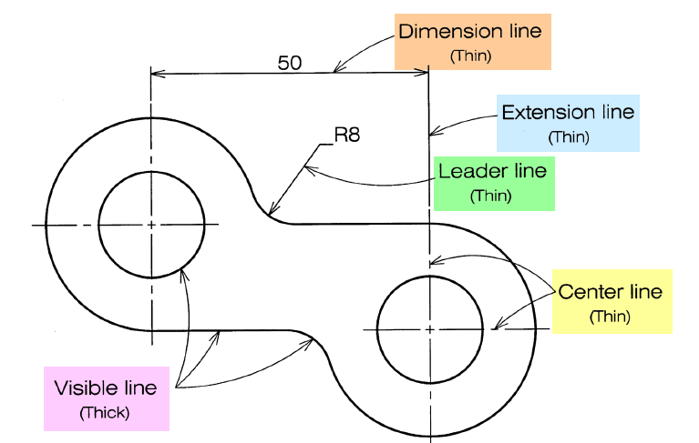
Lines: Example

Slide 21
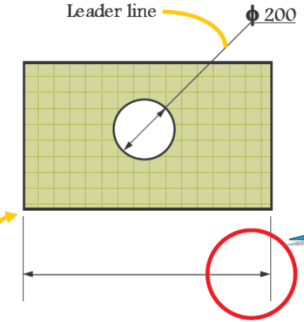
Dimensioning
Most convenient unit of length is millimeter.
Angles are shown in degree
Extension line
Dimension line
Leader line
Arrow heads
Dimensions

Slide 22
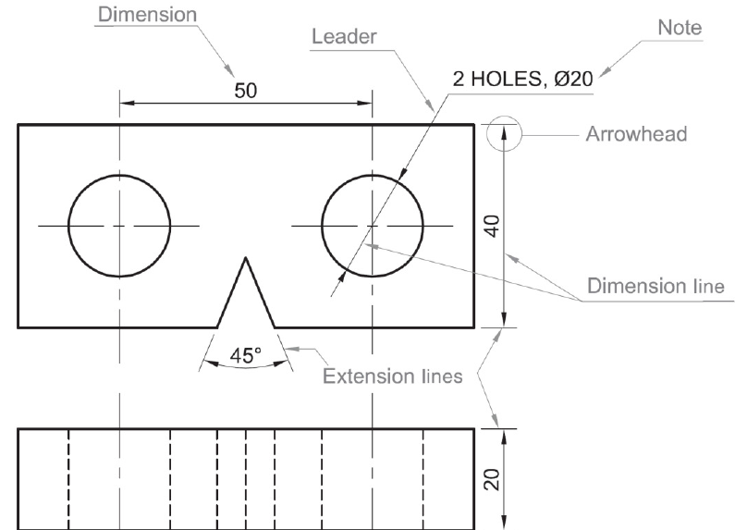
Dimensioning: Example

Slide 23
Dimensioning: Salient Features
Dimension lines should be drawn at least 10 mm away from the outlines
Smaller dimension should be placed near the view and the larger further away
As far as possible dimension should be outside the view
Dimension should be perpendicular to dimension line
All dimensions should be unidirectional
Units should NOT be written after each dimension
Do not repeat the same dimension in different views
Dimension should be given to visible lines and not to hidden lines

Slide 24
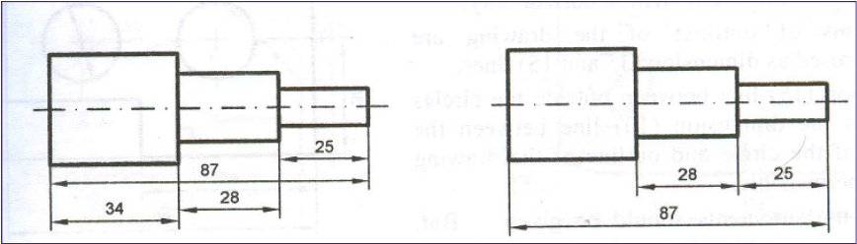
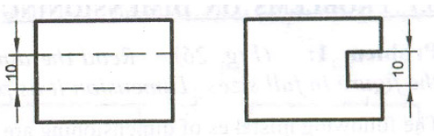
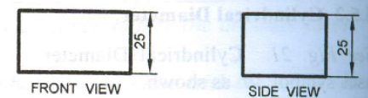
Dimensioning: Dos & Don'ts

Slide 25
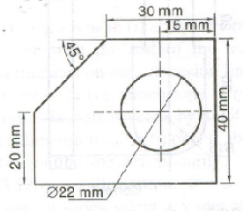
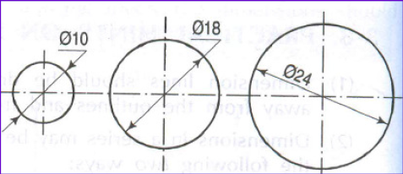
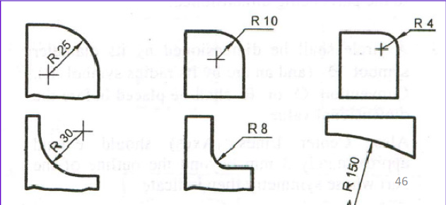
Dimensioning: Arcs & Circles

